Slide 1
Improving College Performance and Retention the Easy Way: Unpacking the ACT Exam
Eric Bettinger, Brent Evans, and Devin Pope
Discussion by Jeff Denning

Slide 2
What is the question?
Are the components of the ACT equally predictive of college GPA and dropout?
What components would be most predictive?
What gains would there be to reweighting admissions?

Slide 3
Why is this interesting?
Colleges are interested in the success of their students and this could increase the success
However, the social benefit is smaller because if a student is rejected from one institution they likely will go to another

Slide 4
Are the authors interested in causal effects?
No
Why?
They are interested in prediction (same as the colleges)

Slide 5
Data
Administrative data on all public, four year college attendees in Ohio
They know college performance, persistence, demographic characteristics, ACT scores, high school performance
BYU data from 1997 and 1998

Slide 6
Empirical Approach
Straightforward regression of outcomes on subscores
Test for equality of the coefficients (Why? Current practice presumes that all subsections matter equally)

Slide 7
Results
Overall ACT is predictive
Each subscore is predictive individually
After controlling for all subscores, Math and English are still predictive whereas Science and Reading are not
What do the previous two bullets imply about the correlation between Math and Science?
What should they control for?
This is true for dropout and GPA

Slide 8
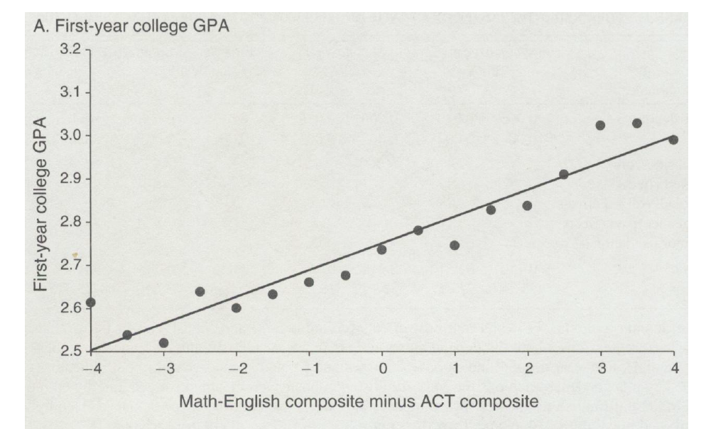
Figure that says it all

Slide 9
Issues of Interpretation
They are limited by the variation in the sample. What is the sample here? enrolled students)
What would be a problem for their interpretation?
What if ACT score predicts going to college?
How do they address this? High School GPA, BYU sample, Community College Sample
Why is this a good application of regression? Is this a causal estimate?
Does this mean we should stop teaching reading and science in high school?

Slide 10
Simulation
They run a simulation where they use their preferred measure of college readiness
They assume that students are admitted only on the basis of ACT. All of the best students go to the 1st best college, the next best students go to the next best college, etc. Are these assumptions right? Does it matter?
This increases graduation rates at top schools and decreases them at bottom schools

Slide 11
Recap
Regression can be great depending on the context.
As with most things in this class, interpretation is key

